Slide 1
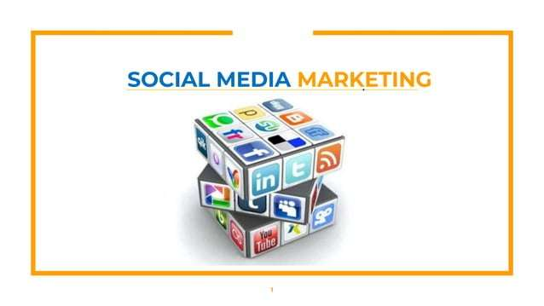

Slide 2
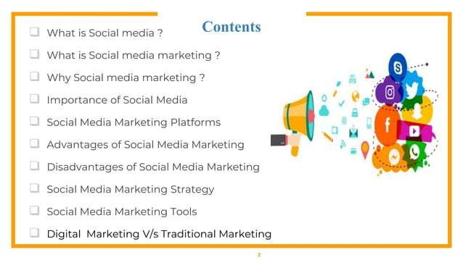

Slide 3
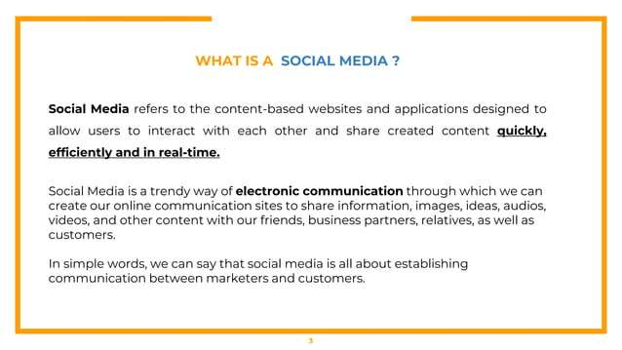

Slide 4
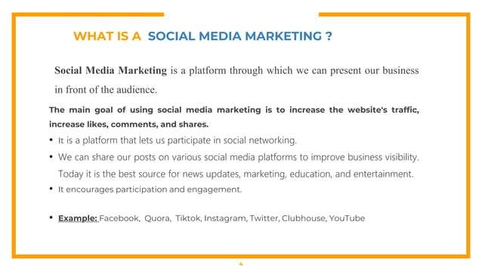

Slide 5
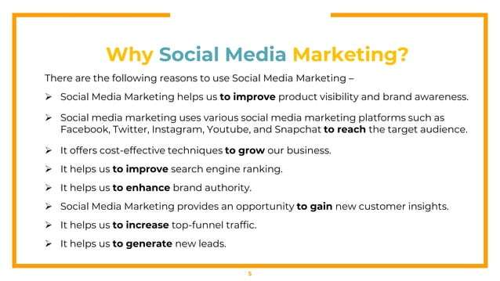

Slide 6
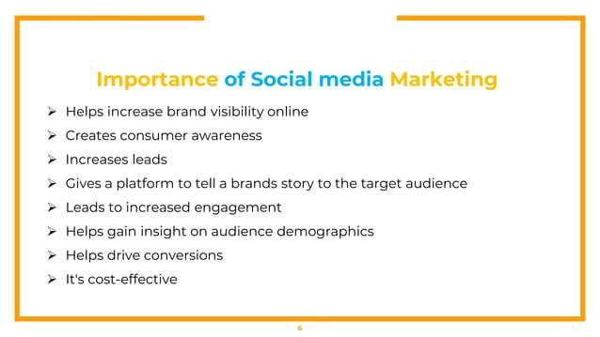

Slide 7
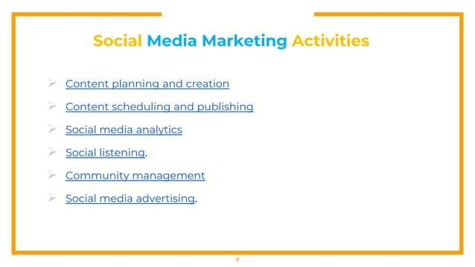

Slide 8
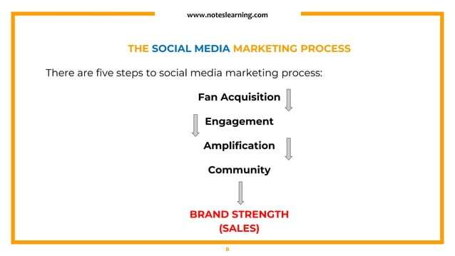

Slide 9
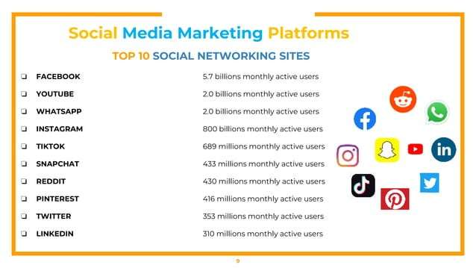

Slide 10
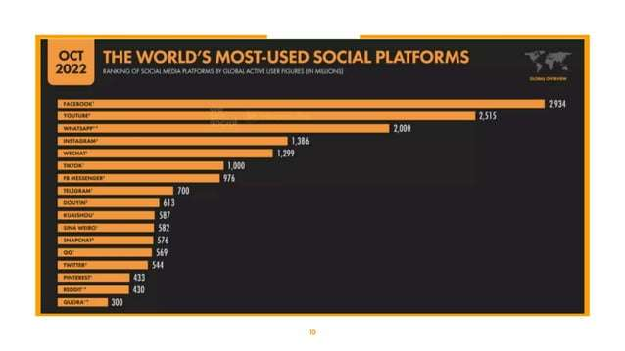

Slide 11
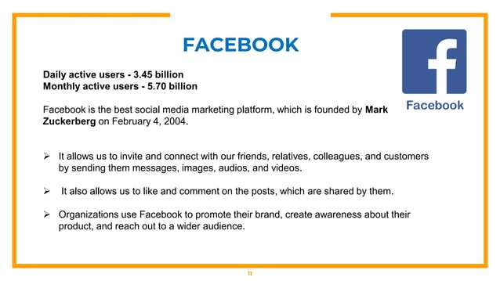

Slide 12
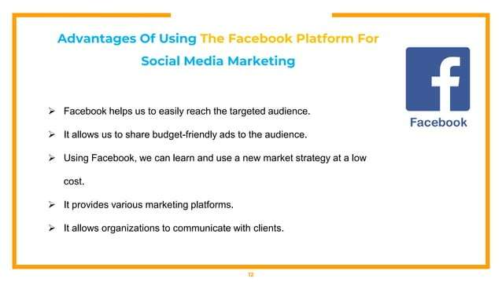

Slide 13
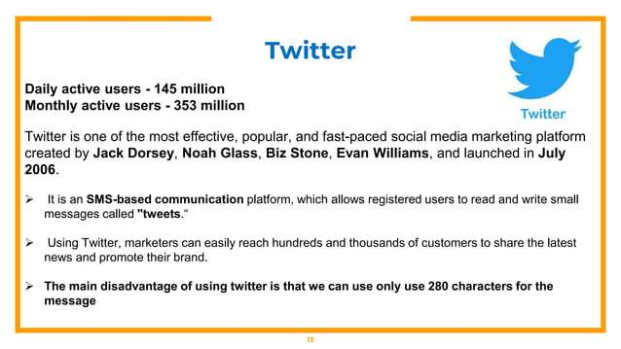

Slide 14
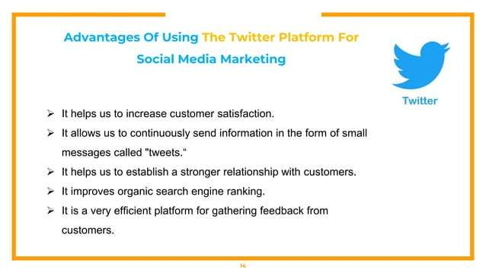

Slide 15
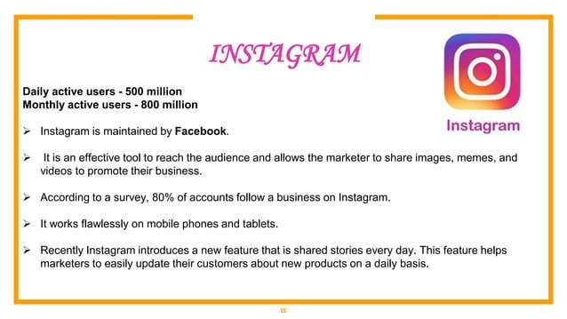

Slide 16
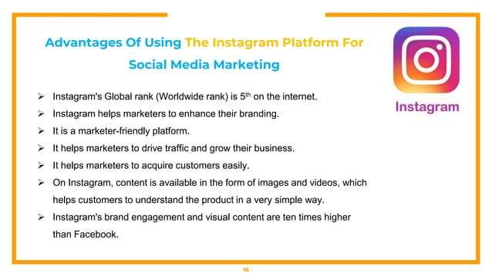

Slide 17
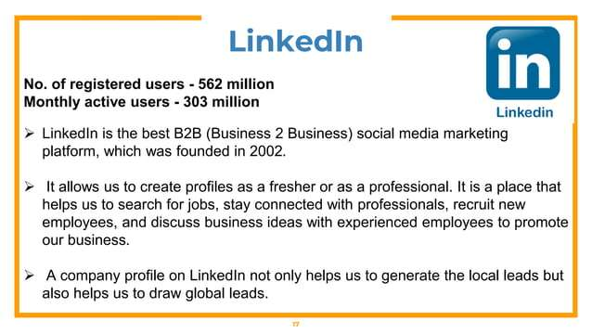

Slide 18
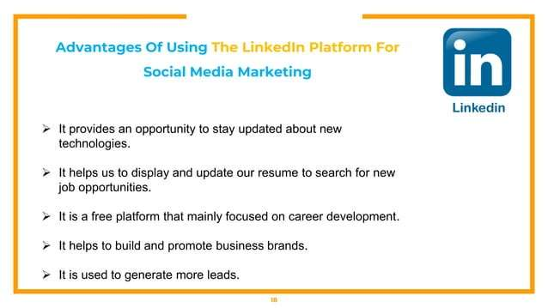

Slide 19
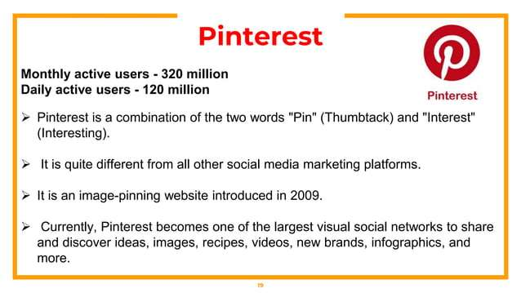

Slide 20
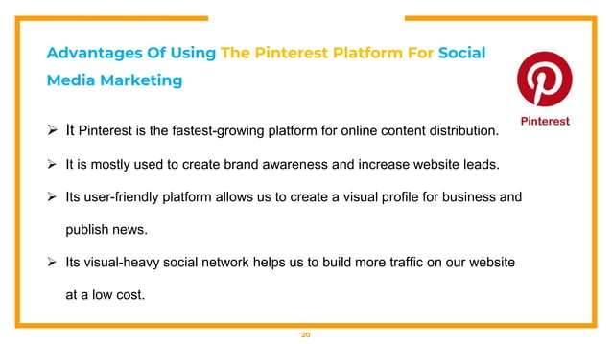

Slide 21
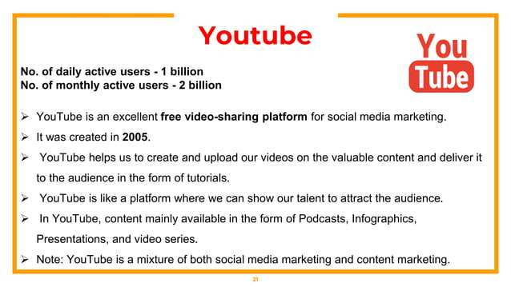

Slide 22
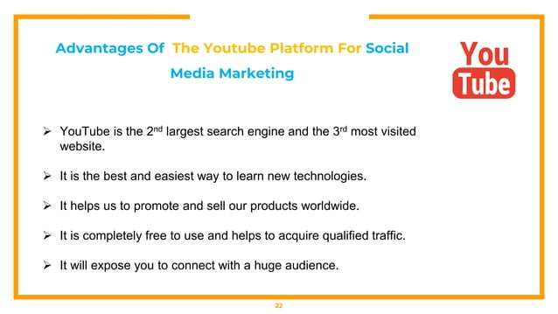

Slide 23
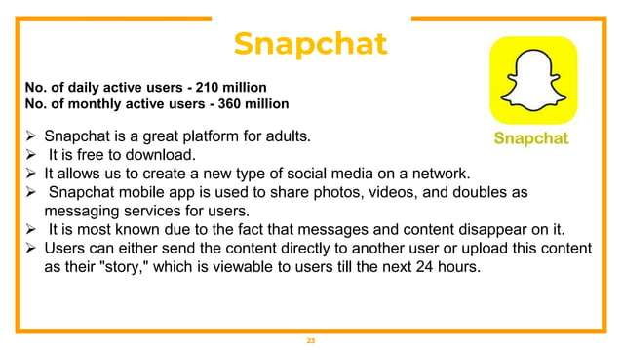

Slide 24
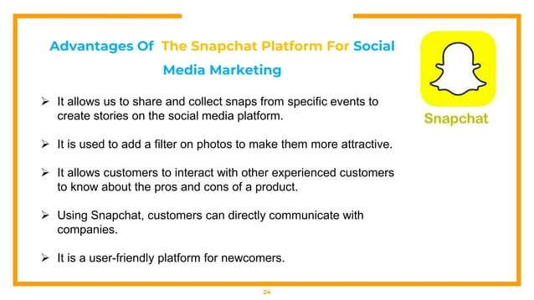

Slide 25
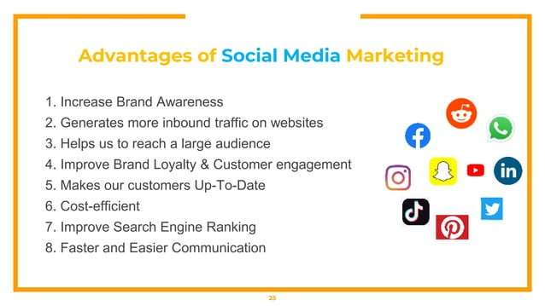

Slide 26
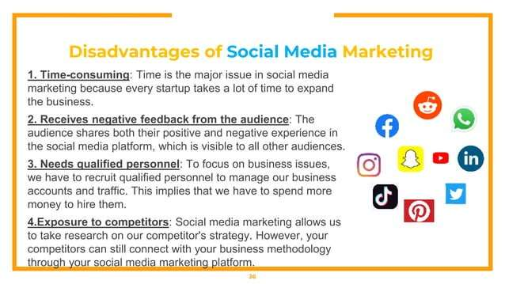

Slide 27
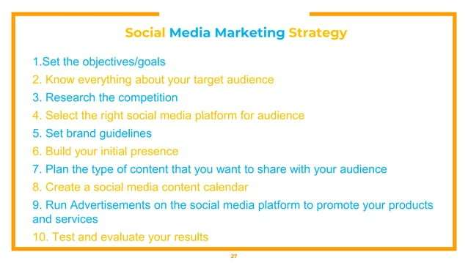

Slide 28
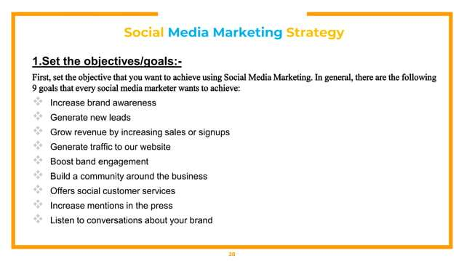

Slide 29
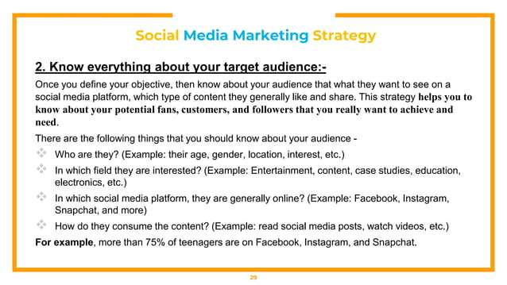

Slide 30
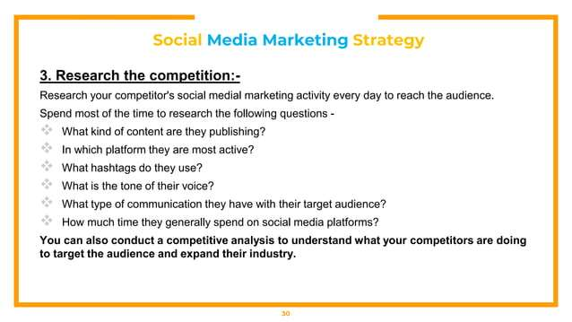

Slide 31
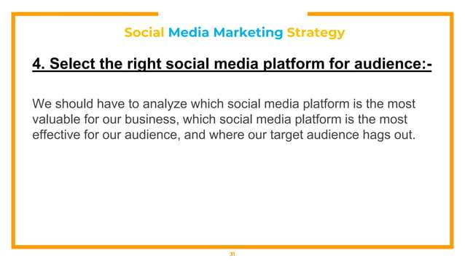

Slide 32
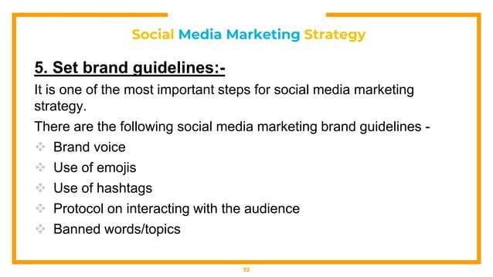

Slide 33
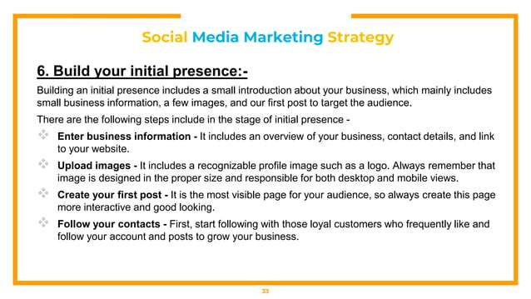

Slide 34
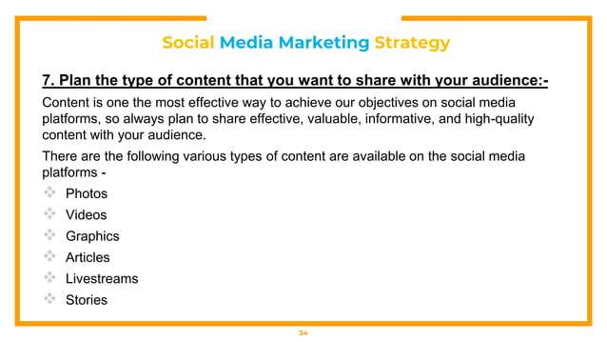

Slide 35
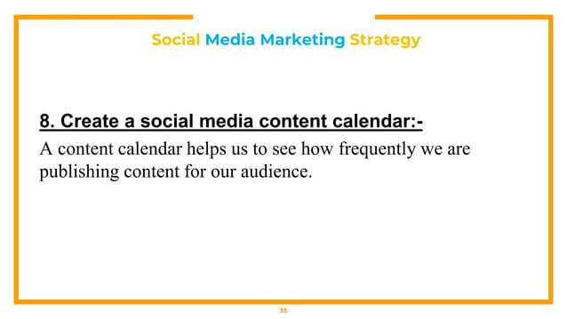

Slide 36
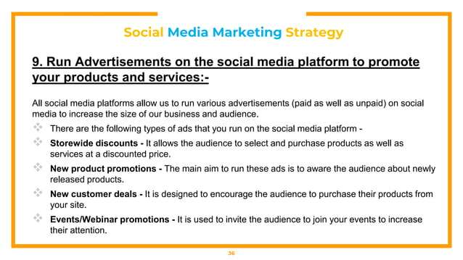

Slide 37
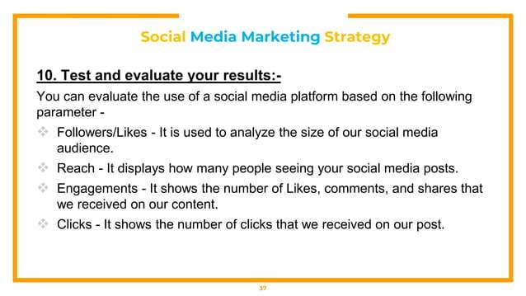

Slide 38
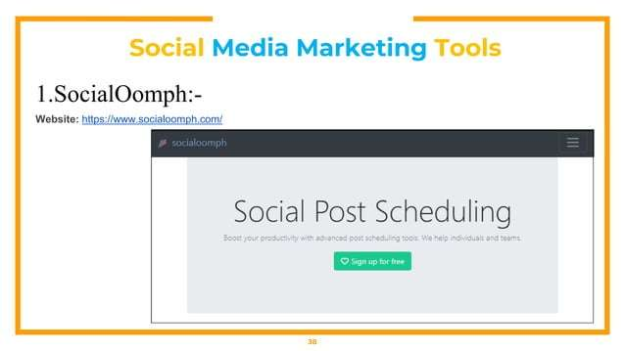

Slide 39
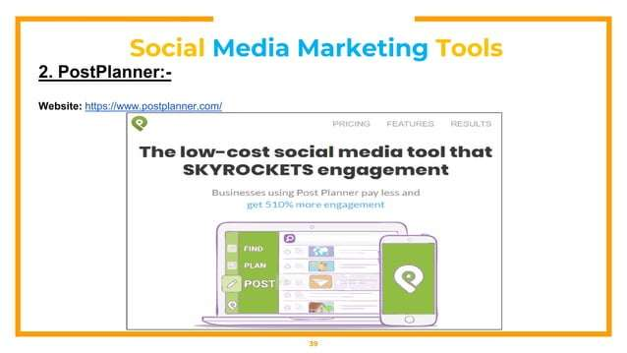

Slide 40
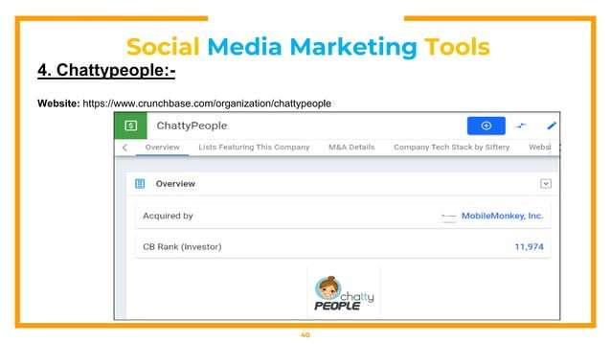

Slide 41
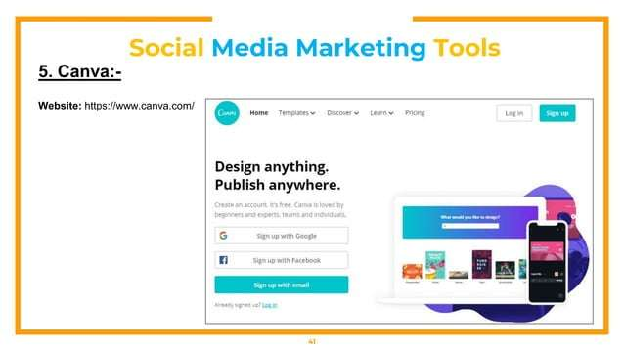

Slide 42


Slide 43
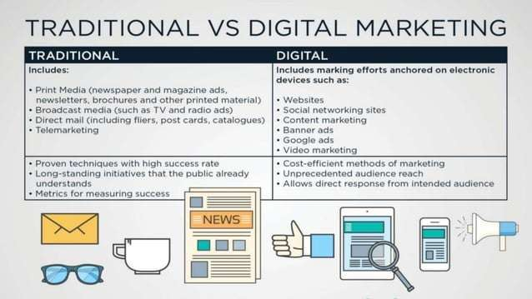

Slide 44
Segmenting B2C Market
Market segmentation is a key process in marketing where a large consumer market is divided into smaller, manageable groups that share similar characteristics, behaviors, or needs.
In B2C (Business-to-Consumer) marketing, segmentation helps companies identify and understand different types of consumers so that social media and promotional messages can be customized for each segment.
The goal is to reach the right people, with the right message, at the right time.

Slide 45
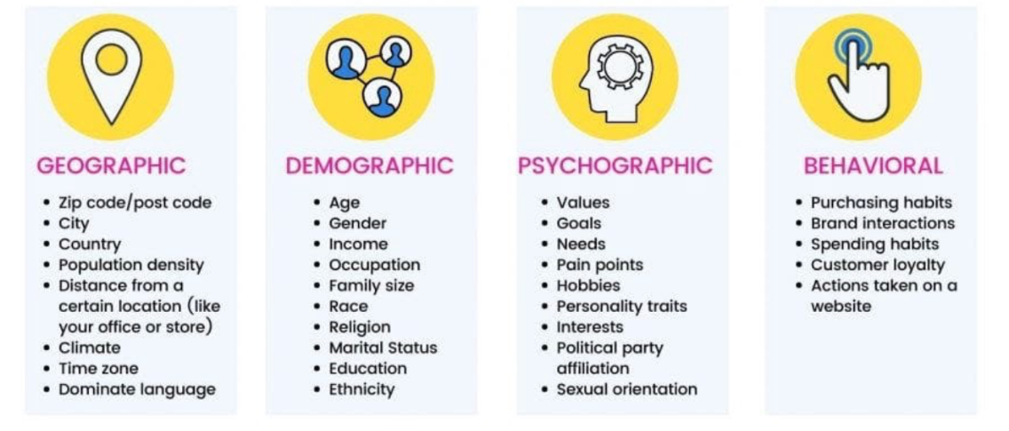
Main Types of B2C Segmentation

Slide 46
Demographic Segmentation
This is the most common and simplest form of segmentation. It divides consumers based on quantifiable characteristics, such as:
Age (teens, adults, seniors)
Gender (male, female, non-binary)
Income level (low, middle, high)
Occupation and education
Family size and marital status
Example: A cosmetics brand may target women aged 25–45 with higher income; a gaming company may focus on males aged 18–30.
Social Media Use: Platforms like Facebook Ads or Instagram Ads allow targeting based on these demographics.

Slide 47
Geographic Segmentation
This segmentation divides the market based on location such as:
Country, region, city, postal code, or climate zone.
Example: A sunscreen brand targets tropical regions; a winter apparel company focuses on colder regions.
Social Media Use: Marketers can target users by geolocation, local hashtags, or location-based ads (for example, “near me” searches).

Slide 48
Geographic Segmentation
Life-Stage or Behavioral Segmentation
This approach focuses on consumer behavior patterns or life stages that affect buying habits. It includes:
Life events: graduation, marriage, parenthood, retirement
Usage rate: heavy, medium, or light users
Brand loyalty: loyal vs. switchers
Example: Parents of toddlers often buy educational toys and baby care products, while retirees may seek travel offers.
📍 Social Media Use: Facebook segments audiences based on life events (such as “newly engaged” or “just moved”).

Slide 49
Psychographic Segmentation
This focuses on values, attitudes, interests, and lifestyles (AIOs) — understanding why people buy. It involves classifying people by:
Personality traits (adventurous, practical, ambitious)
Motives and aspirations
Social class and lifestyle choices
Example: Adventure travelers look for outdoor gear and experiences, while eco-conscious buyers prefer sustainable brands.
📍 Social Media Use: Psychographic targeting is used to align content tone — e.g., inspirational posts for achievers, humorous ones for trendsetters.

Slide 50
Affinity or Interest Group Segmentation
This segmentation focuses on shared passions, hobbies, and communities. People naturally cluster into online groups or networks around similar interests — sports, reading, fitness, gaming, etc.
Example: A fitness brand targets “yoga lovers” or “cyclists” on Instagram or Facebook groups.
Social Media Use: Platforms like LinkedIn Groups, Facebook Groups, and Reddit communities are valuable for affinity targeting.

Slide 51
Advantages:
Helps identify niche markets within the broader audience.
Allows personalized marketing and improved customer engagement.
Improves ad performance and ROI by targeting precise consumer clusters.
Supports better content creation — tone, style, and platform use differ for each segment.
Example: A luxury brand will use elegant imagery and exclusive offers, while a youth-focused brand uses humor and trending challenges.

Slide 52
Researching B2B Markets
Business-to-Business (B2B) market research focuses on understanding how companies buy products or services from other companies.
Unlike B2C (Business-to-Consumer) markets — where individuals make purchase decisions — B2B buying involves multiple decision-makers, longer sales cycles, and higher-value transactions.
Therefore, social media strategies for B2B marketing must focus more on relationships, trust, credibility, and expertise rather than direct selling.

Slide 53
Key Characteristics of B2B Marketing
Longer Sales Cycle Purchases often take weeks or months and involve evaluation, approval, and negotiation steps.
Multiple Decision-Makers Buying decisions are made by a team — such as executives, managers, and technical staff — not just one person.
High-Value Purchases Products or services often represent significant financial investment (e.g., software systems, machinery, consulting).
Focus on Relationships Companies value trust, credibility, and problem-solving ability more than flashy ads.

Slide 54
B2B Research Objectives
The goal of researching B2B markets is to:
Identify who the decision-makers are,
Understand what influences their buying process, and
Find which social media platforms they use most frequently.

Slide 55
Using Social Media for B2B Research
LinkedIn – The most powerful professional platform for identifying key decision-makers, company pages, and networking groups.
Networking for Professionals (NFP) – A site for connecting business professionals in specific industries.
SitePoint and other B2B directories – Useful for researching niche industries and company networks.
Quantcast, Alexa, and Google Trends – Tools that provide data on audience demographics, traffic, and engagement trends for B2B-focused websites.
Content Marketing Institute Reports – Highlight how more than 93% of B2B marketers use social media to promote their products or services.

Slide 56
Social Media Focus for B2B
B2B companies use social media mainly for:
Branding and top-of-mind visibility
Customer support and loyalty
Thought leadership (e.g., publishing industry insights)
Problem-solving through content (e.g., case studies, how-to guides)
Unlike B2C marketing — which is often sales-driven — B2B marketing builds authority and long-term trust.

Slide 57
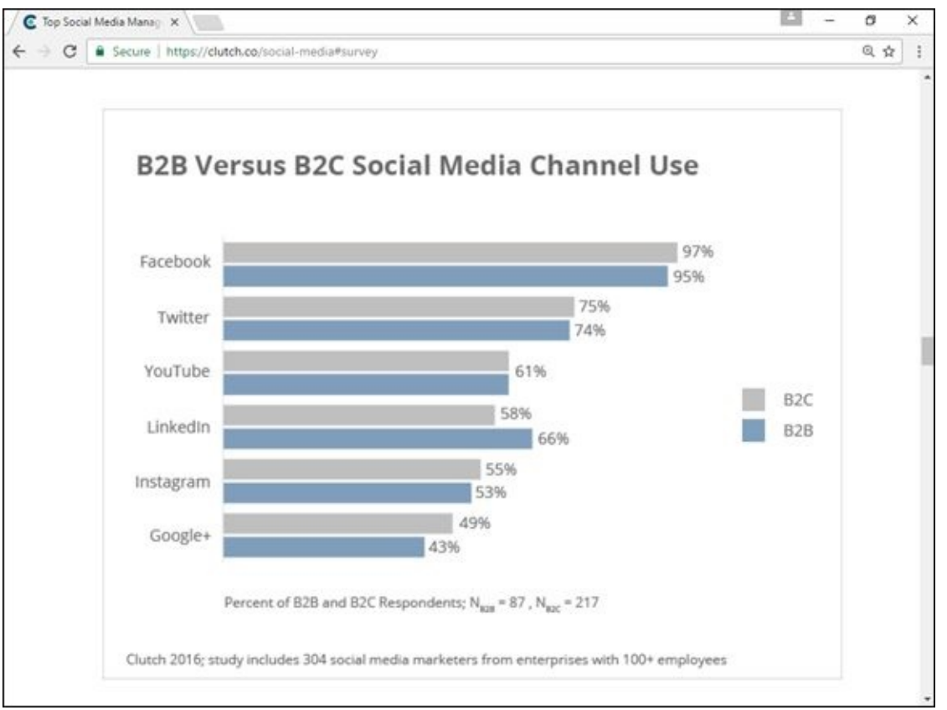
Example:
B2B companies tend to use LinkedIn, Twitter, and blogs more,
While B2C companies prefer Facebook, Instagram, and YouTube.
This demonstrates how social media channel selection depends on target audience, industry type, and business goals.

Slide 58
Conducting Other Types of Market Research Online
The book explains that online research is essential for understanding audience behavior, identifying influencers, and choosing the best social media strategies.
With the vast amount of data available online, marketers must focus their efforts efficiently rather than getting lost in excessive information.
You don’t need to perform academic-level research; instead, focus on practical, business-oriented research that supports decision-making and marketing execution.

Slide 59
Start with a Strategic Plan
Before diving into online research, set clear goals:
What information do you need (e.g., audience, competitors, influencers)?
How will this information improve your marketing strategy?
What online platforms or tools best serve your purpose?
Set aside a specific time (a week or two) for focused research before launching your campaigns.

Slide 60
Practical Market Research Focus
This emphasizes two key research areas:
a) Identifying Influential Sites and Users
Identify top influencers—individuals or companies who drive conversations in your industry.
Study their content type, frequency of posting, engagement rate, and follower base.
Use tools like:
Twitaholic (twitaholic.com) — ranks Twitter users by followers and activity.
Brandwatch and Ragan — help find industry influencers.
Insight: The most frequent posters are not always the most influential; influence comes from engagement, not volume.

Slide 61
b) Understanding Audience Motivation
Analyze why people use certain platforms — entertainment, information, community, or self-promotion.
Align your brand’s tone and content with audience motivation.
Example: Users on LinkedIn seek professional content, while Instagram users prefer visuals and creativity.

Slide 62
Experiment and Learn
Test strategies on a small scale first — observe what works best for your brand.
The book stresses that what works for others may not work for you, so base conclusions on your own business results.
Monitor engagement metrics such as shares, likes, clicks, and comments to evaluate success.

Slide 63
Useful Tools for Online Market Research
Some reliable online resources mentioned include:
Quantcast, Alexa, Google Trends → analyze audience demographics and site traffic.
HubSpot and SimilarSites → identify competing websites and industry statistics.
Social Media Examiner and MDG Advertising reports → provide updated social media trends.

Slide 64
Outcome of Online Market Research
After completing online research, you should be able to:
Recognize key influencers in your market.
Understand audience interests, behaviors, and needs.
Determine the most suitable social media platforms for your brand.
Build a data-driven marketing plan with measurable goals.

Slide 65


Slide 66
